Slide 1

Project 3 Regression & Classification
Ames Housing Data

Slide 2
PART ONE:
MODELING THE SALES PRICES OF HOUSES BASED ON THEIR FIXED FEATURES

Slide 3

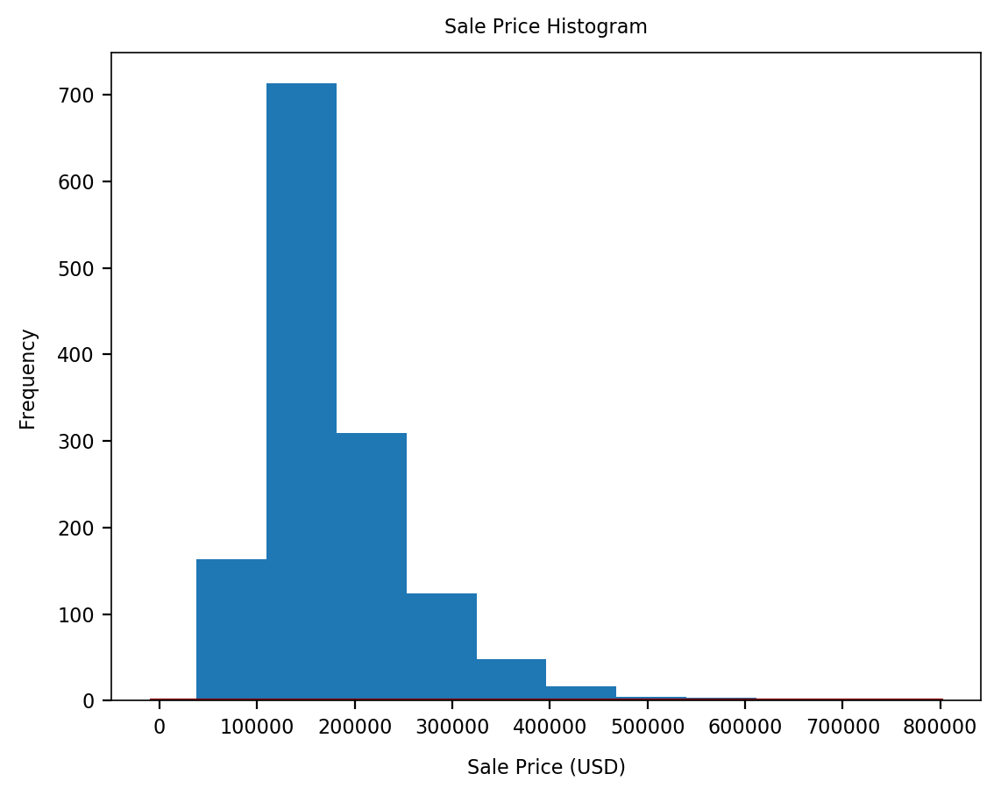
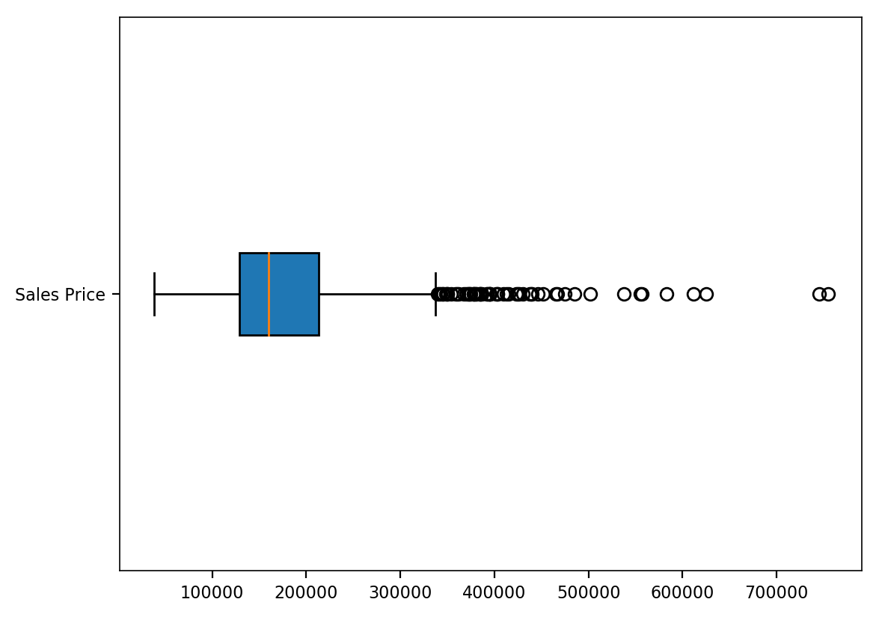
Overview of Home Sales
Notes:
Initial EDA showed that a number of features had missing values, which would need to be managed appropriately before modelling. Before doing this however, I started by examining the target variable’s (i.e. the SalesPrice) descriptive statistics. The Pandas DataFrameSummary object and the boxplot (below) showed:
A mean and median sale price of $180,136 and $160,000 respectively, indicating a positive skew, which was confirmed by both a histogram of the Sale Price, and positive kurtosis and skewness values
A sale price range from $37,500 to $755,000, with 61 outliers – defined here as sales price > 75th percentile + 1.5 * interquartile range. The 95th percentile ($325,925) was also considerably less than the maximum sale price.

Slide 4
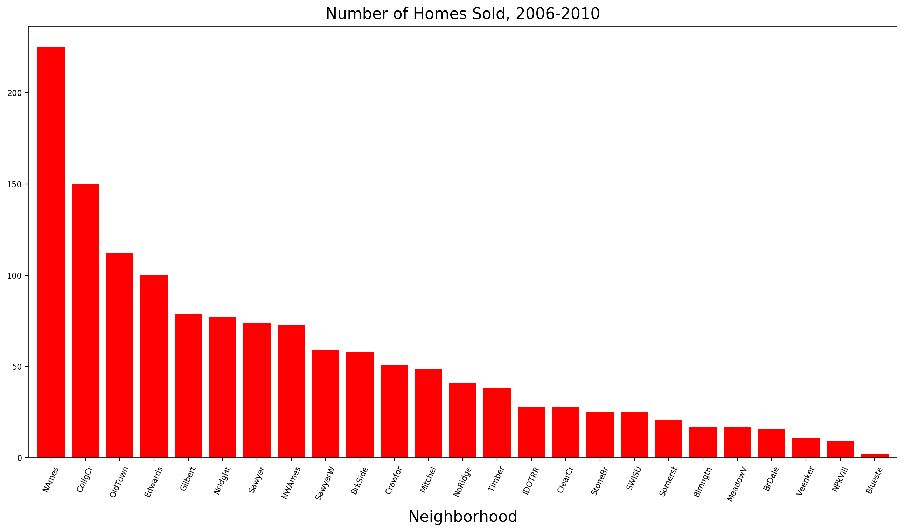
Sales : Neighborhood
The neighborhoods with the most sales (e.g., North Ames, College Creek, Old Town, Edwards, Gilbert)add text

Slide 5
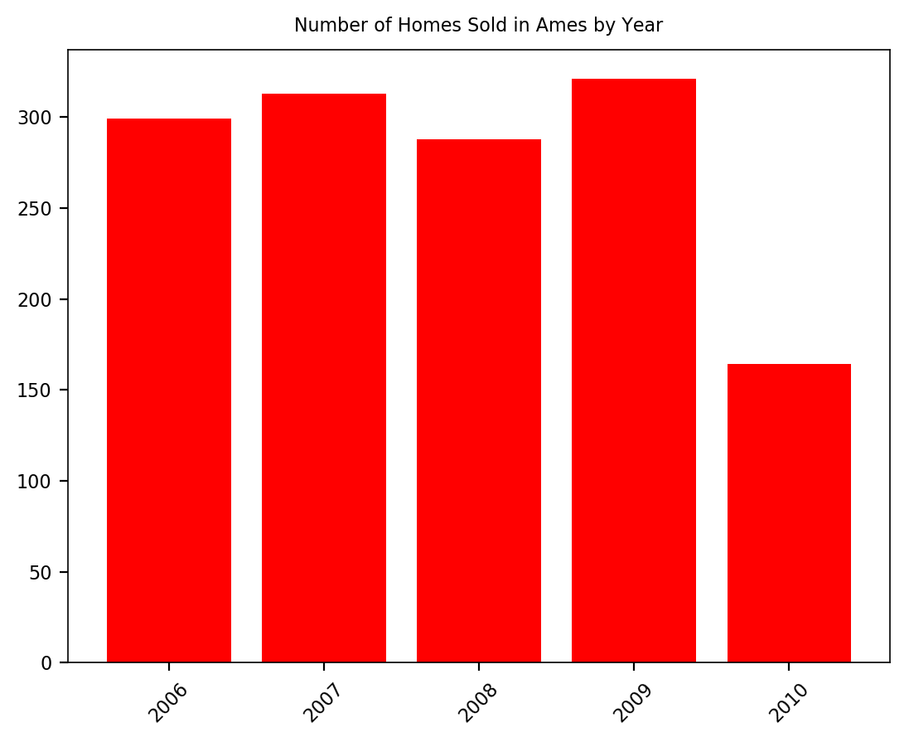

Slide 6
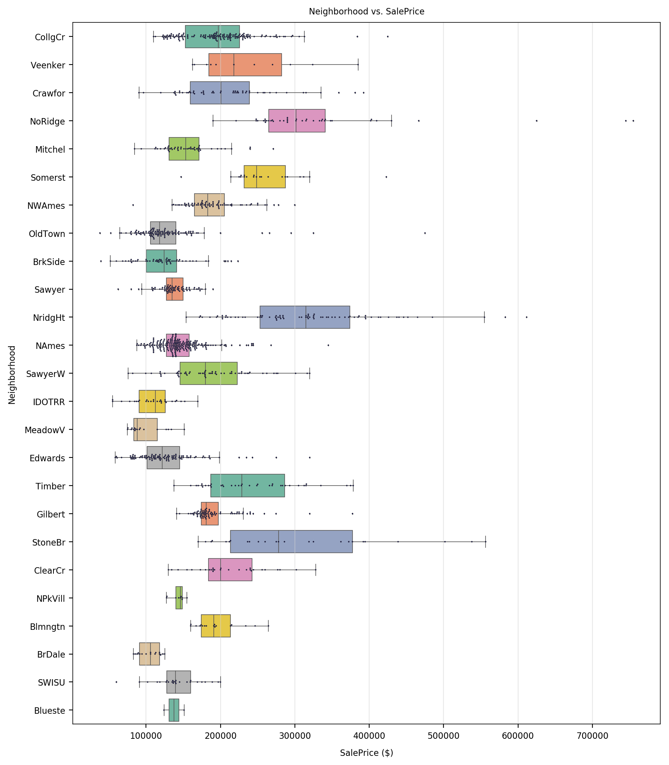
Neighborhoods predictor for Sale Price,
Good distribution of data across the different neighborhoods
Significant variation in sales price across the different category values.

Slide 7
Correlations between numerical, fixed features and sales price
Person correlation > +- 0.5 between SalePrice and:
TotalBsmtSF (+/-062)
GrLivArea (+/- 0.71)
FullBath (0.59)
TotRmsAbvGrd (0.54)
Fireplaces (0.62)
TotalLivingSF (0.79)

Slide 9
Proposed numeric predictors:
['YearRemodAdd', 'TotalBsmtSF', 'GrLivArea', 'FullBath', 'GarageCars', 'Fireplaces', 'WoodDeckSF', 'OpenPorchSF']
Proposed categorical predictors:
['Neighborhood', 'LotShape', 'Condition1', 'BldgType', 'HouseStyle', 'Foundation', 'BsmtQual', 'BsmtExposure', 'GarageType']
All proposed predictors:
['YearRemodAdd', 'TotalBsmtSF', 'GrLivArea', 'FullBath', 'GarageCars', 'Fireplaces', 'WoodDeckSF', 'OpenPorchSF', 'Neighborhood', 'LotShape', 'Condition1', 'BldgType', 'HouseStyle', 'Foundation', 'BsmtQual', 'BsmtExposure', 'GarageType']

Slide 10
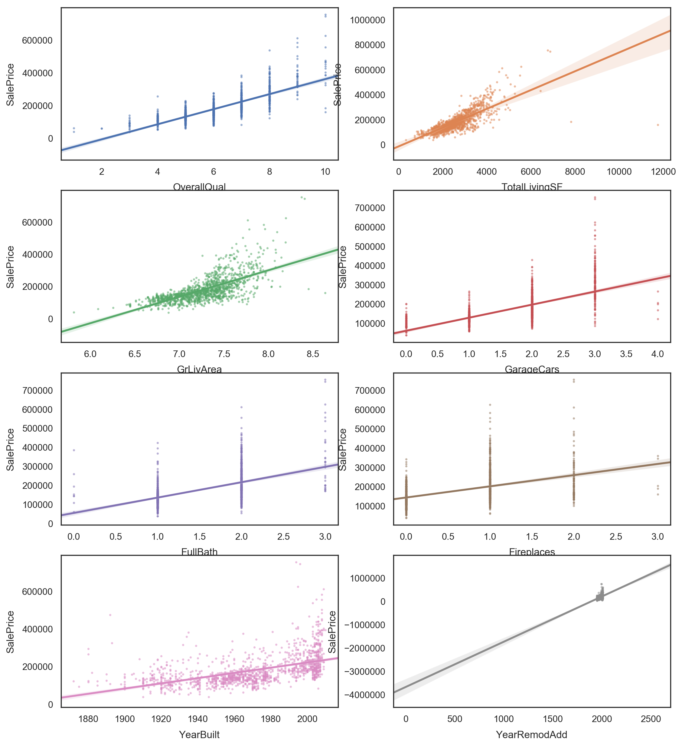

Slide 11
Train and evaluate Linear Regression Model
R2 score on training data: 0.856 R2 score on test data: 0.867
Baseline prediction: $177821

Slide 12
Model evaluation with root mean squared error
Root Mean Square Error of model on test data is: $29482
Root Mean Square Error of model on train data is: $30223
The RMSE is quite good, and similar for the training and test data

Slide 13
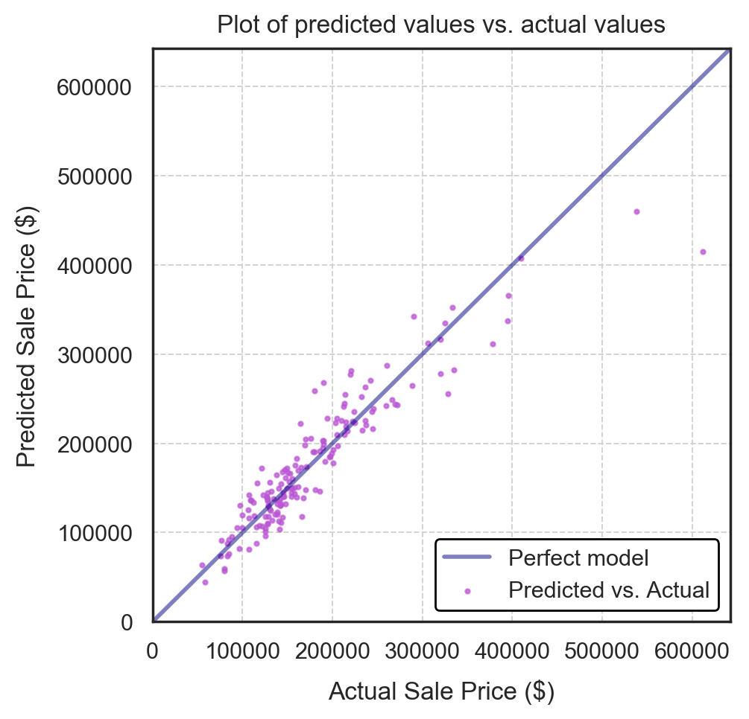
There are a couple of sales with high values that aren't represented well by the model and have large residuals. However percentage wise it looks like the models fits quite good.

Slide 14
Cross validation and Regularization grid search
R2 score of optimum Ridge on test data: 0.862
Ridge regularisation has yielded no improvement on the model performance.

Slide 15
Lasso
R2 score for optimum Lasso model on test data: 0.858
The optimum Lasso model performs very similar to the Ridge regularisation, so there's not much difference here

Slide 16
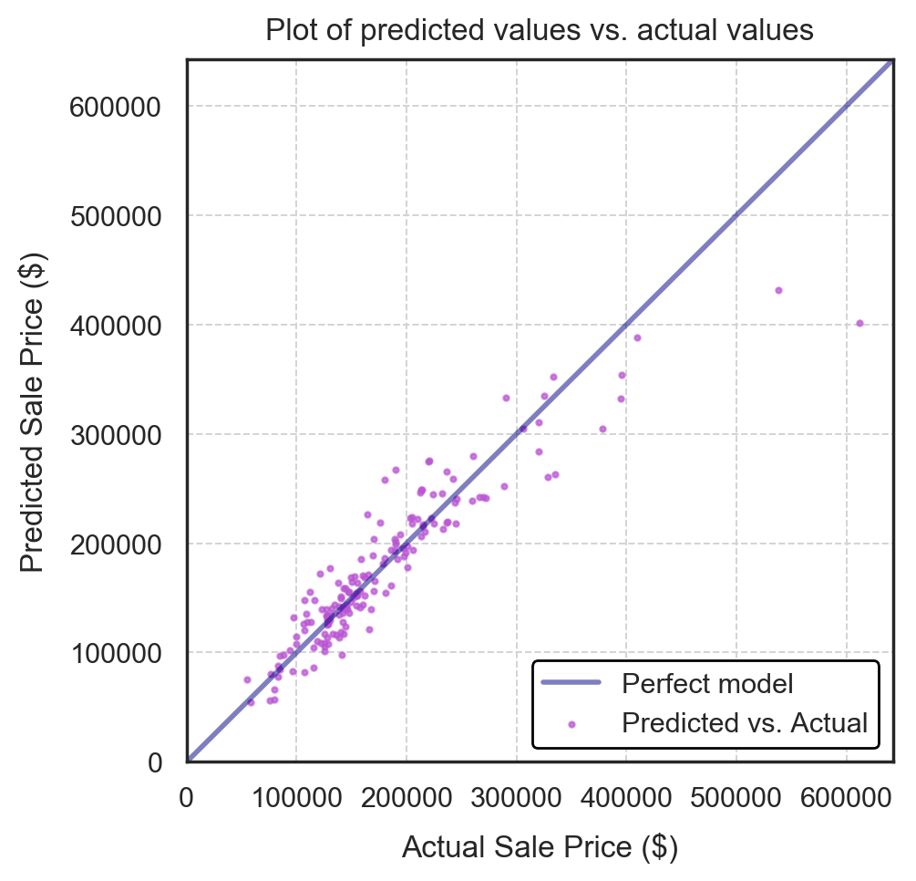
The model performs well on the test set, apart from 2 data points at the upper extreme of the actual sales price range, and a property around the $180K value.
The standard Linear Regression model performs just as well as the Lasso and Ridge models. Since the Lasso model reduces dimensions there was no significant improvement to the model.
For this data sets the Linear regression works well and cannot be improved with other methods, however it's just good to check if performance can be improved with some tweaks.

Slide 17
Determine any value of changeable property characteristics unexplained by the fixed ones

Slide 18
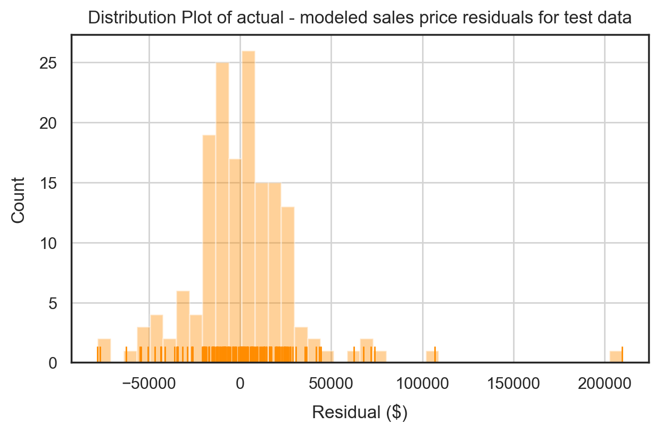
Test
The distribution of residuals is approximately normal - centered around 0 - with one large outlier corresponding to the high value property identified in the 'predicted vs actuals' plot above

Slide 19
Summary
The chart above provides further evidence as to why the model's accuracy in predicting the residuals is relatively poor. 2 of the 3 most important/significant predictors are OverallQual and OverallCond which both had a relatively low correlation with the target (residuals) itself! With Lasso it was completely removed from the predictions.
We are predicting the dollar amount now, but note it is in terms of ERRORS of the first model. If the first model overestimated the price for a house, then the error in price (residual) would be negative. We are predicting these residuals. The \-$5586 coefficient for MasVnrArea means this feature is "worth" -$5586 dollars i.e it is predicted to be \-$5586 dollars greater by the model.
Many of these features would do well to be converted onto a numeric scale to make them more interpretable.
I would not trust first model model either as an indicator of which properties to buy (based on their fixed features), then again I wouldn't trust a model's ability to accurately identify which properties to renovate and how. Fixed features can be identified better however you need to know on average how much it cost to fix the selected areas.

Slide 20
